Slide 1
1. Introduction to Programming and Python
Email address and other info for ideas and suggestions

Slide 2
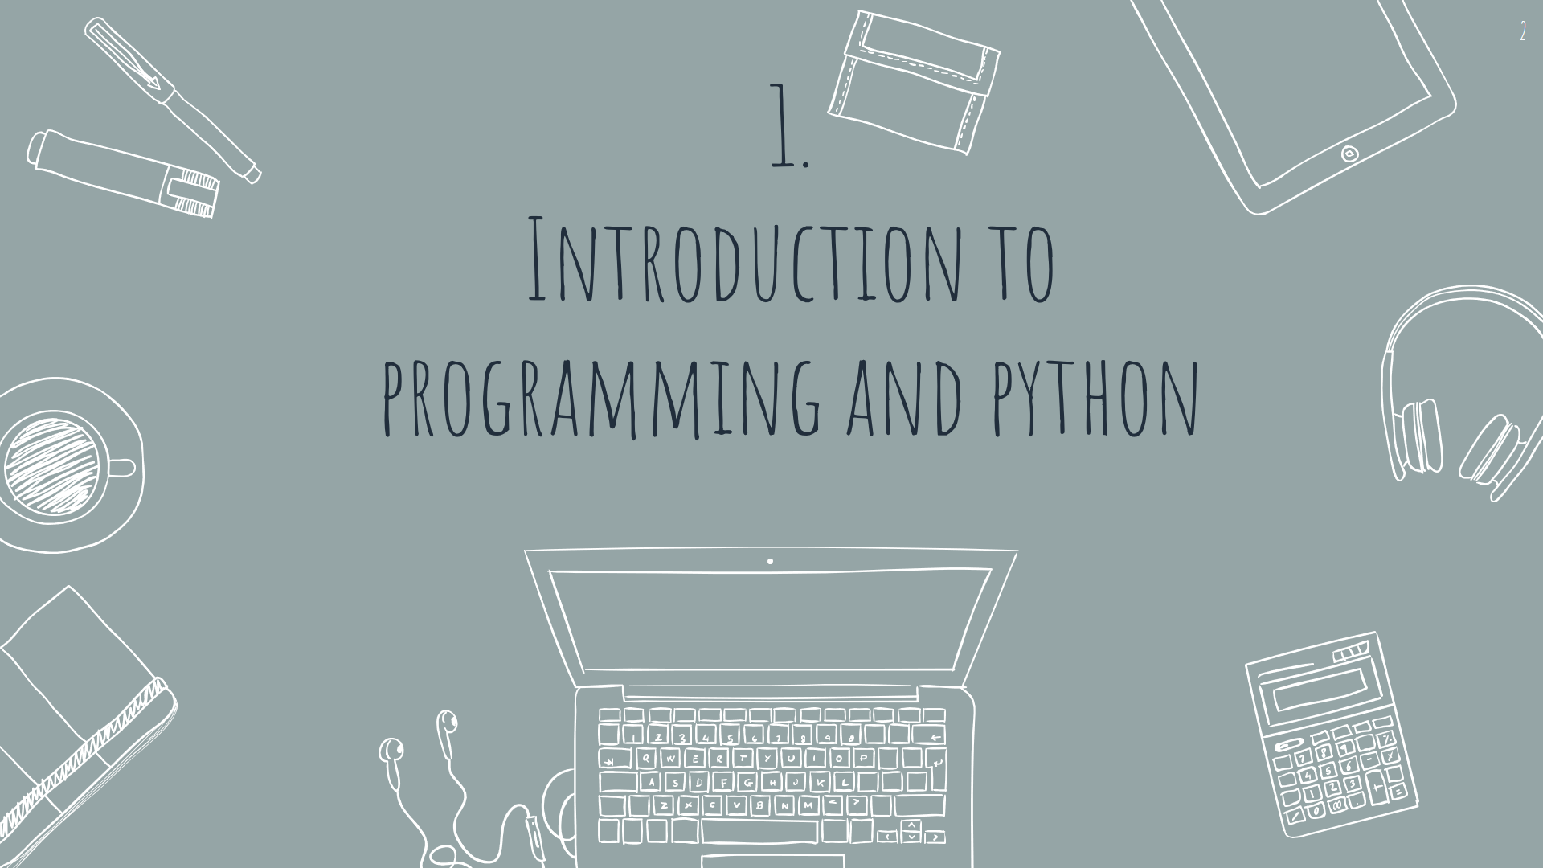

Slide 3
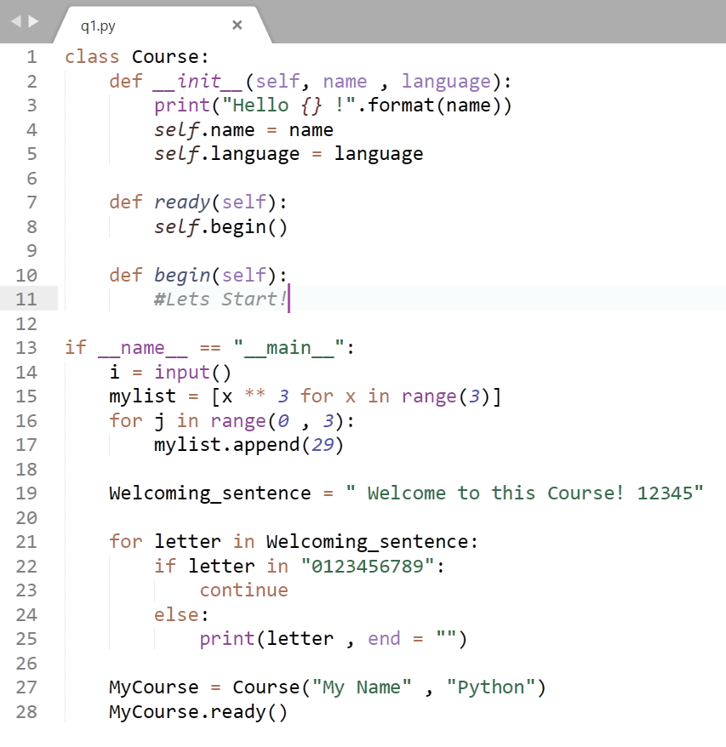
Welcome!
Welcome to the Python Hero Academy.
In this course, you'll learn programming with python from basics to advanced. Take a real college-like course without the limitations of one!

Slide 4
Contents
What is Programming?
1
High level and low level languages
2
Interpeted and Compiled languages
3
A very simple description of what programming languages are
What they are and a simple comparison between them
What they are and a simple comparison between them

Slide 5
“Everybody should learn how to program a computer, because it teaches you how to think.”
—Steve Jobs

Slide 6
Important information
Bluh bluh bluh bluh

Slide 7
1. Title
A summary

Slide 8
Title
Main Explanation

Slide 9
Dividing to two
Pros :
1.
2.
3.
4.
Cons :
1.
2.
3.
4.

Slide 10
Dividing to two
Pros
Cons
1.
2.
3.
4.
5.
1.
2.
3.
4.
5.

Slide 11
Timeline (Other modules also available)
DAY 1
DAY 3
DAY 5
DAY 2
DAY 4

Slide 12
123
1
2
3
First one
Second
Third one

Slide 13
Infographics …
MARS
Despite being red, Mars is a cold place, not hot
JUPITER
It’s a gas giant and the biggest planet in our Solar System
VENUS
Venus has a beautiful name, but it’s terribly hot

Slide 14
… and the same goes for tables
 | MASS (earths) | DIAMETER (earths) | SURFACE GRAVITY (earths)
MERCURY | 0,06 | 0,38 | 0,38
MARS | 0,11 | 0,53 | 0,38
SATURN | 95,2 | 9,4 | 1,16

Slide 15


